Slide 1
Controllers
ASP .NET course – lesson 1
© Ayala Gottfried

Slide 2
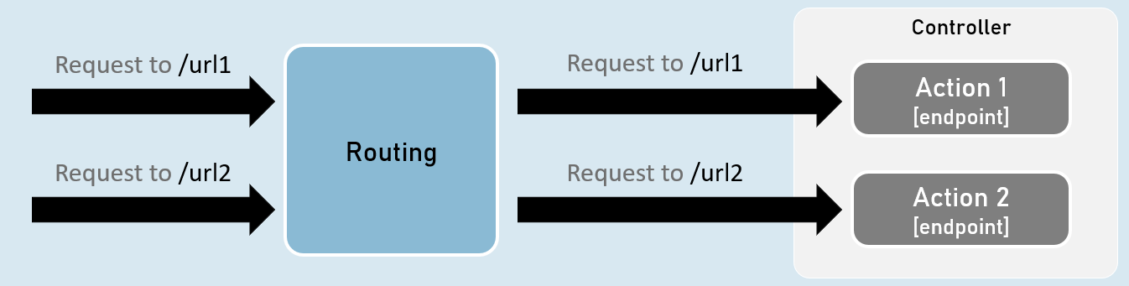
What is a controller?
A controller is a class that is used to group up a set of actions (or action methods)
Action methods do perform certain operations when a request is received & return the result (response)
A controller often represents a single resource

Slide 3
Controllers responsibilities
Reading requests
Validation
Invoking SERVICES
Preparing response

Slide 4
Controllers Definition
Class name suffix is Controller (or [Controller] attribute)
Class is derived from ControllerBase
Class is defined as public
[ApiController] attribute
using Microsoft.AspNetCore.Mvc;
namespace Net7SampleProject.Controllers
{
[ApiController]
[Route("api/students")]
public class StudentsController : ControllerBase { }
}

Slide 5
Actions Definition
Method is defined as public
[Http<Method>] attribute (optional – default to function name prefix or GET)
[Route(<url>)] attribute, can be combined with the [Http<Method>] attribute (optional)
[HttpGet(“{id}”]
public ActionResult<Student> GetStudent(int id) {
return new Student();
}

Slide 6
Add controllers to project
Add all controllers as services to app builder.Services.AddControllers();
Add all action methods as endpoints app.MapControllers();

Slide 7
ControllerBase class
The ControllerBase class is a base class for controllers in ASP.NET Core that handles HTTP requests.
It provides a set of common properties and methods controllers use to handle HTTP requests and generate HTTP responses.
The ControllerBase class does not implement any specific behavior or logic but instead provides a set of common methods and properties that derived classes can use.

Slide 8
[ApiController] attribute
The [ApiController] attribute is used to simplify and enhance the behavior of API controllers with several features:
Attribute routing requirement
Automatic model validation with detailed errors
Binding sources parameters interface

Slide 9
Action method return type
Specific type
IActionResult
ActionResult<T>

Slide 10
ActionResult<T>
object result (T)
status code result
file result
redirect result

Slide 11
Status Code result
BadRequestResult – 400 Bad Request
return new BadRequest();
UnauthorizedResult – 401 Unauthorized
return new Unauthorized();
NotFoundResult – 404 Not Found
return new NotFound();
StatusCodeResult
return new StatusCode(status_code);

Slide 12
Routing

Slide 13
Route URL - Exampales
/api/books
Return all books
/api/books/{id}
Return specific book

Slide 14
Default route parameter
{parameter=defaultValue}
Optional route parameter
{parameter?}
Route constraint
{parameter:constraint}
Route template
{[controller]}

Slide 15
Route Constraints
Constraint | Description | Example
alpha | Matches uppercase or lowercase Latin alphabet characters (a-z, A-Z) | {x:alpha}
bool | Matches a Boolean value. | {x:bool}
datetime | Matches a DateTime value. | {x:datetime}
decimal | Matches a decimal value. | {x:decimal}
double | Matches a 64-bit floating-point value. | {x:double}
float | Matches a 32-bit floating-point value. | {x:float}
guid | Matches a GUID value. | {x:guid}
int | Matches a 32-bit integer value. | {x:int}
length | Matches a string with the specified length or within a specified range of lengths. | {x:length(6)} {x:length(1,20)}
long | Matches a 64-bit integer value. | {x:long}
max | Matches an integer with a maximum value. | {x:max(10)}
maxlength | Matches a string with a maximum length. | {x:maxlength(10)}
min | Matches an integer with a minimum value. | {x:min(10)}
minlength | Matches a string with a minimum length. | {x:minlength(10)}
range | Matches an integer within a range of values. | {x:range(10,50)}
regex | Matches a regular expression. | {x:regex(^\d{3}-\d{3}-\d{4}$)}

Slide 16
CRUD operations
Get
Get by ID
Post
Put
Delete

Slide 17
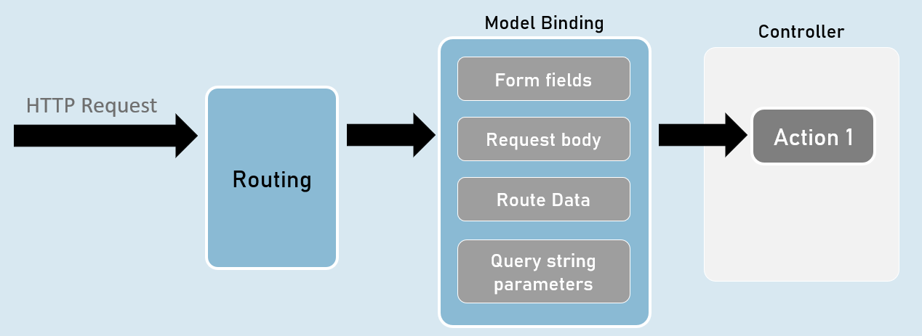
Model Binding
Model Binding is a feature of asp.net core that reads values from http requests and pass them as arguments to the action method.

Slide 18
Model Binder
Reads the parameters from the request
Pass the parameters to the requested action
Convert the parameters to the requested type
Update the arguments of the action method

Slide 19
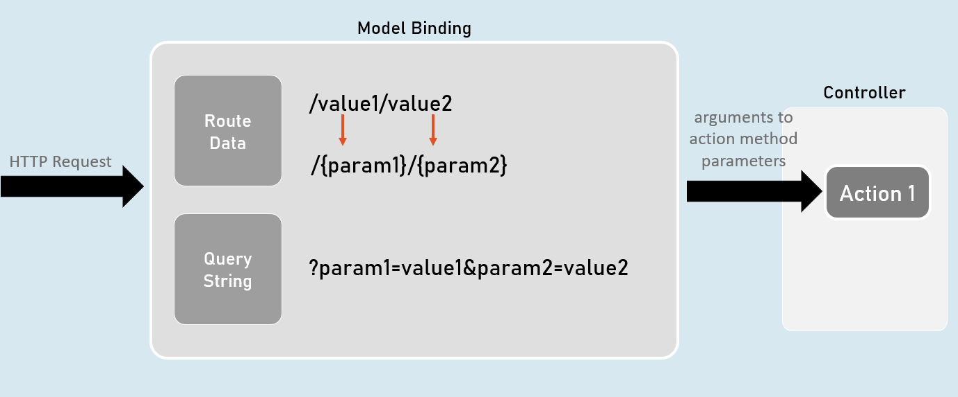
Sources

Slide 20
Sources
query [FromQuery]
route [FromRoute]
body [FromBody]
header [FromHeader]

Slide 21
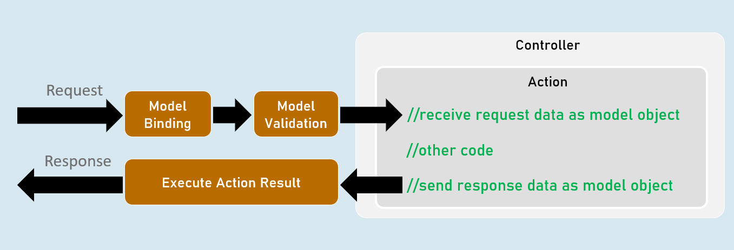
Model Validation

Slide 22
Validation Attributes
Indicates that a property or parameter should be excluded from validation.
[CreditCard]:
Validates that the property has a credit card format. Requires jQuery Validation Additional Methods.
[Compare]:
Validates that two properties in a model match.
[EmailAddress]:
Validates that the property has an email format.
[Phone]:
Validates that the property has a telephone number format.
[Range]:
Validates that the property value falls within a specified range.
[RegularExpression]:
Validates that the property value matches a specified regular expression.
[Required]:
Validates that the field isn't null. See [Required] attribute for details about this attribute's behavior.
[StringLength]:
Validates that a string property value doesn't exceed a specified length limit.
[Url]:
Validates that the property has a URL format.
[ValidateNever]:

Slide 23
Common WebAPI attributes
[ApiController]
[HttpMethod]
[Route]

